Slide 1
TEAM MEMBERS
Bahusya Bonthala
Snigdha Reddy Yeruva
Akash Reddy Cheviti

Slide 2

GAME OF CHESS USING AI
Chess is a board game for two players. Chess is an abstract strategy game and involves no hidden information. It is played on a chessboard with 64 squares arranged in an eight-by-eight grid. At the start, each player controls sixteen pieces: one king, one queen, two rooks, two bishops, two knights, and eight pawns. The player who moves first controls white pieces, and the other controls black pieces. The object of the game is to checkmate the opponent's king, whereby the king is under immediate attack (in "check") and there is no way for it to escape. There are also several ways a game can end in a draw.
Artificial intelligence is widely used in everyday situations in the actual world. They offer a wide range of applications that can raise people's quality of life generally. Chess is a game where artificial intelligence is used in a spectacular way.

Slide 3
Index
Pre-requisites
Files Included
Board representation
Selection
How the Chess Pieces Move
Evaluating moves
AI Moves – alpha beta pruning
Checkmate

Slide 4
PREREQUISITES
Python 3.8 version
PIP (performance improvement plan) for libraries installation
Libraries:
PyGame - It is an open-source Python programming language module made to help with the creation of multimedia apps and games.
Time - Gives options for coding time, such as objects, numbers, and strings. Along with serving as a representation of time, it also offers features like waiting while a program runs and calculating the effectiveness of the program.

Slide 5
FILES INCLUDED
• assets folder: Contains all the chess piece sprites used for the game’s graphics.
chess.py: The main program used to run the interface and game. Run this program when starting the game
• board.py: This contains the board class and its methods. Also contains the alphabet method that the computer uses to make moves
• pieces.py: Contains the master class ‘Pieces’ as well as all individual piece classes that inherit the main class.
• ratings.py: Contains the rating class with methods that evaluate the rating of a movie.
• userInterface.py: Contains the user-interface class that is used to play the game and display the game using pygame

Slide 6
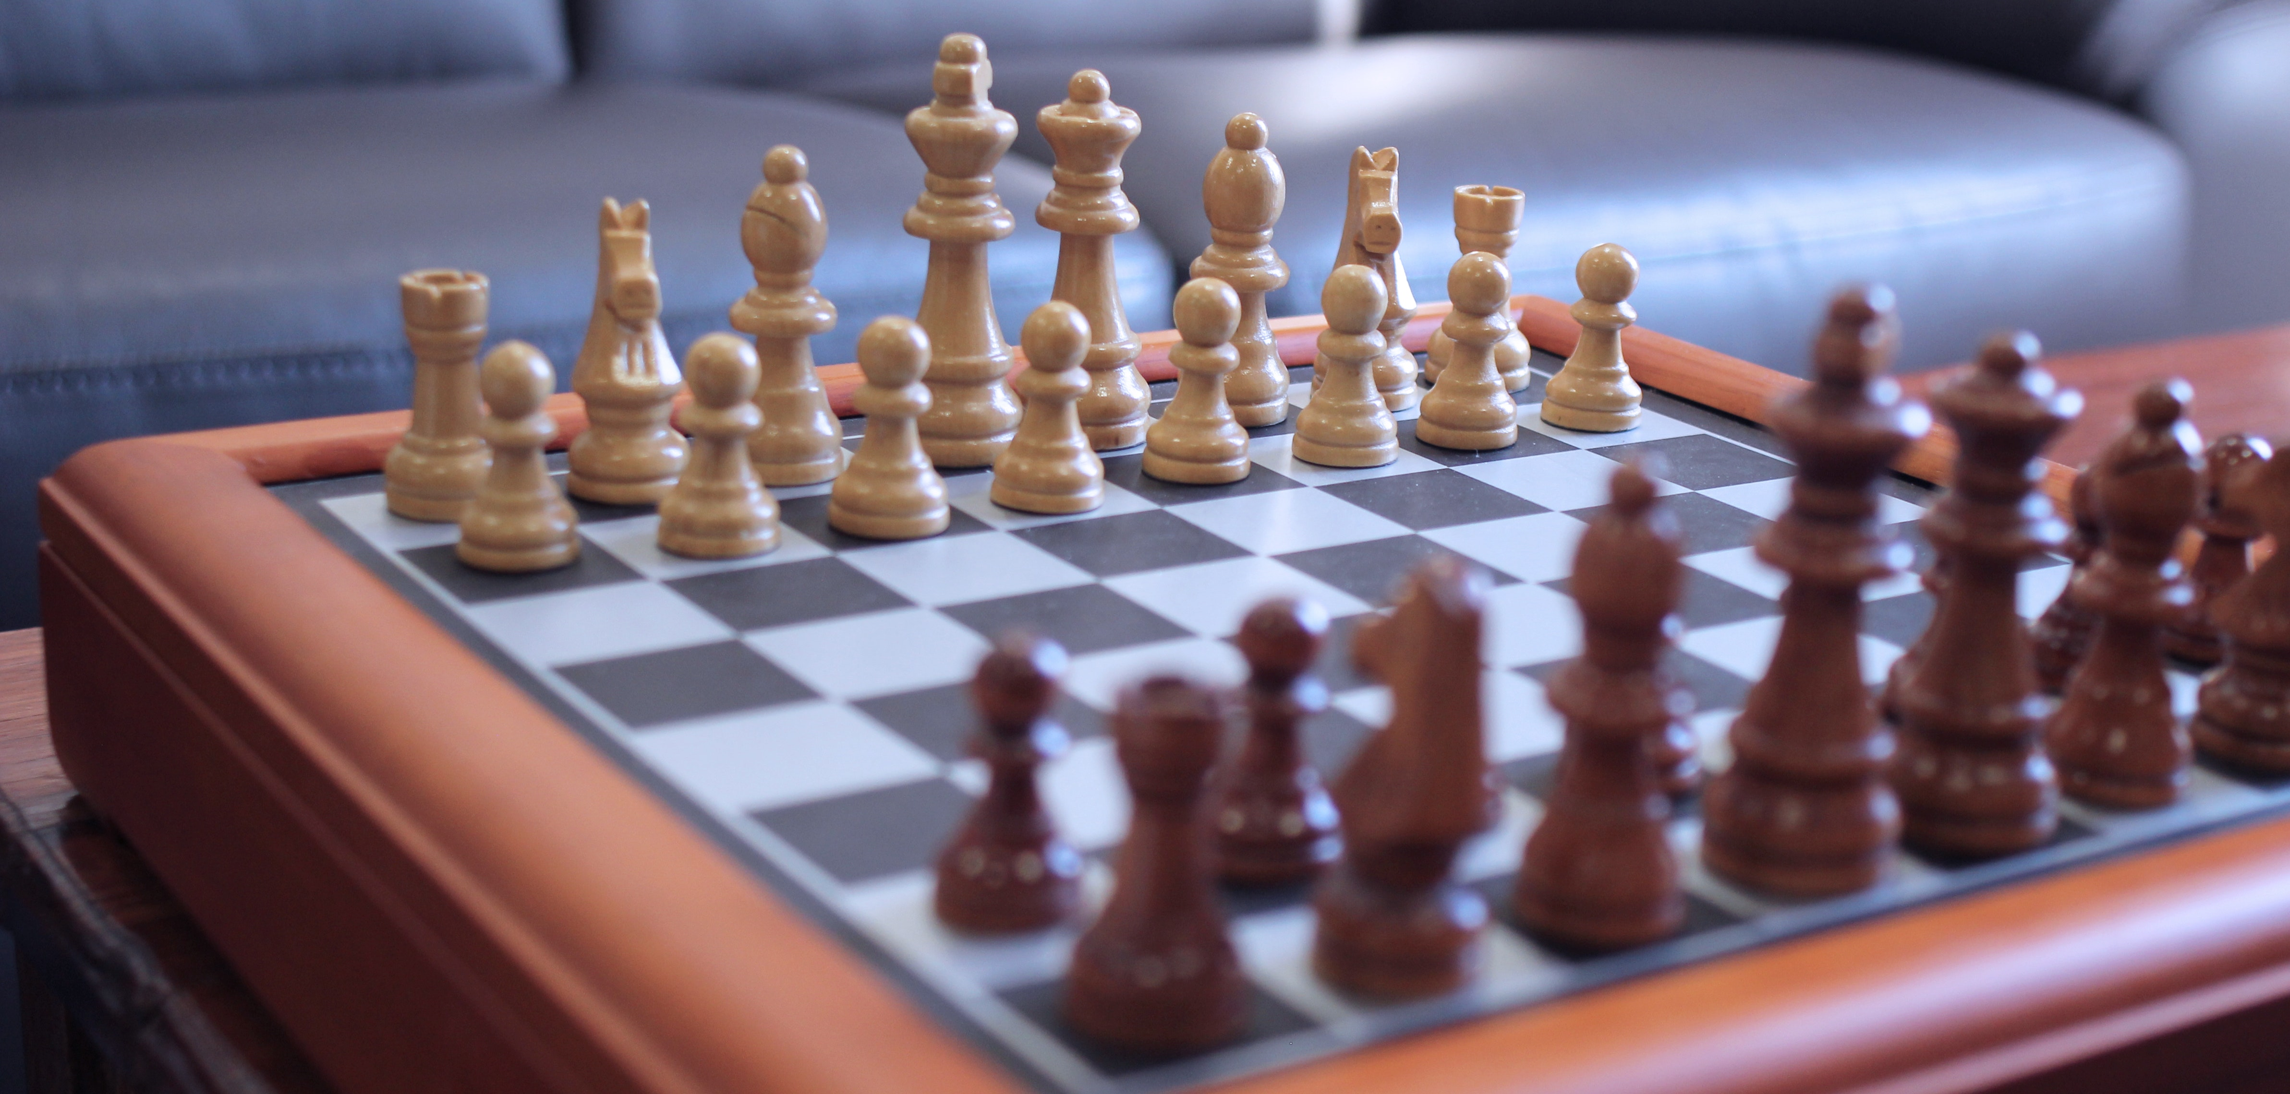
BOARD REPRESENTATION

Slide 7
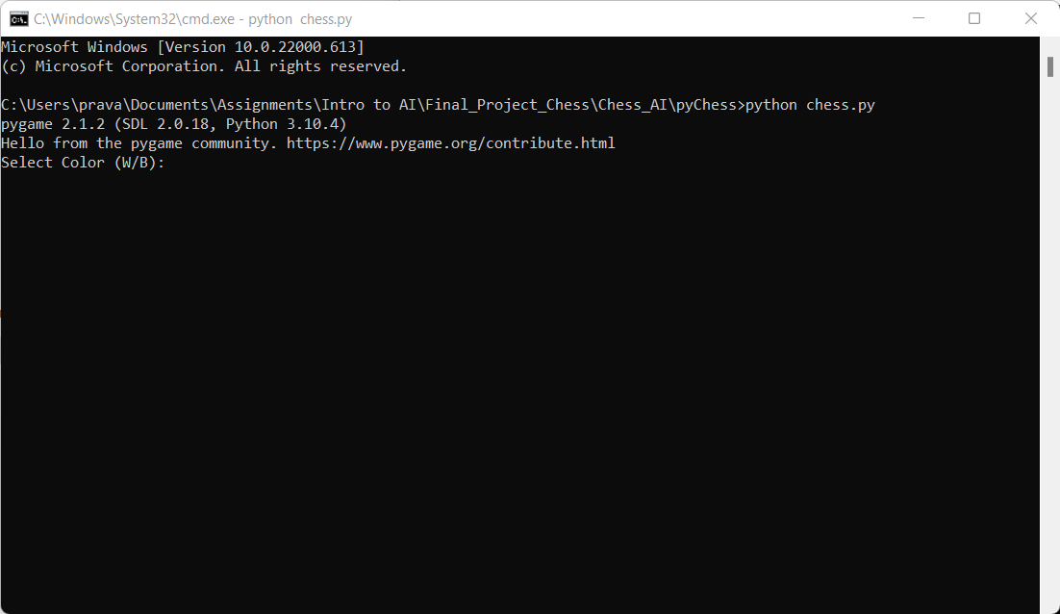
Selection
The player with the white pieces always moves first.
White players get an opportunity to attack right away.

Slide 8
THE MOVEMENT OF CHESS PIECES
King
The king, designated by a crown carrying a cross, is free to move one square in any direction. It can move in any direction—horizontal, vertical, or diagonal.
• Queen
Any number of squares can be moved by the queen in any direction, whether it be horizontally, vertically, or diagonally. By far, this is the most effective component.
• Rook
The rook, which resembles a castle tower, is another strong piece. It has the capacity to zoom in and out of any number of squares on the board, both horizontally and vertically.

Slide 9
Bishop
The bishop has the ability to move up and down the chessboard's diagonals.
The bishop can only move in diagonal directions; it cannot move to squares of a different color. In other words, if your bishop enters the game on a light square, it will always remain there, and if it enters the game on a dark square, it will always remain there.
Knight
The knight moves in the shape of a "L," either moving two spaces vertically and one space horizontally, or vice versa.
Pawns
Pawns can only advance one space unless it is their initial move, in which case they can advance two squares.
Another crucial aspect of the game is that the only component of the army that may go backward is the pawn.

Slide 10
Objectives :
With the use of object-oriented programming, the minimax algorithm, Python, and Pygame, a fully working chess game with player vs. player and artificial intelligence modes will be created for this project.

Slide 11
Approach :
• Tools - Python Interpreter - Visual Studio
• Libraries - PyGame - Numpy
• Techniques (Concepts and Algorithms)
Move generation and board visualization - The move generation basically implements all the rules of chess. Based on this, we can calculate all legal moves for a given board state.
2. Position Evaluation - With the evaluation function, we’re able to create an algorithm that chooses the move that gives the highest evaluation.
3. Search tree using Minimax - creating a search tree from which the algorithm can choose the best move. This is done by using the min-max algorithm.
4. Alpha beta pruning - Alpha-Beta pruning is an optimization method to the minimax algorithm that allows to disregard some branches in the search tree. This also helps to evaluate the minimax search tree much deeper, while using the same resources.

Slide 12
Evaluating moves
Ensuring safe and unsafe moves
Checks

Slide 13
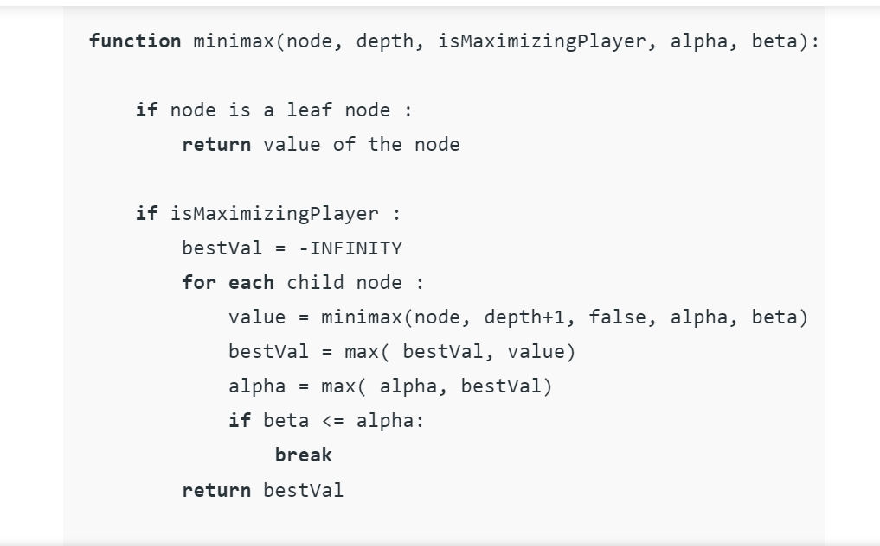
AI Moves – alpha-beta pruning
According to the alpha-beta pruning method, AI agent movement is determined.
The method keeps track of two variables, alpha and beta, which stand for the guaranteed minimum and maximum scores for the maximizing and minimizing players, respectively.
Initially alpha = - infinity and beta = + Infinity
The current maximum depth evaluates up to 3 plys; You can set self.MAXDEPTH = 4

Slide 14
CHECKMATE

Slide 15
Deliverables :
The GitHub link
chess game video

Slide 16
Evaluation methodology :
contrasting the time complexity with other chess games played online

